Slide 1

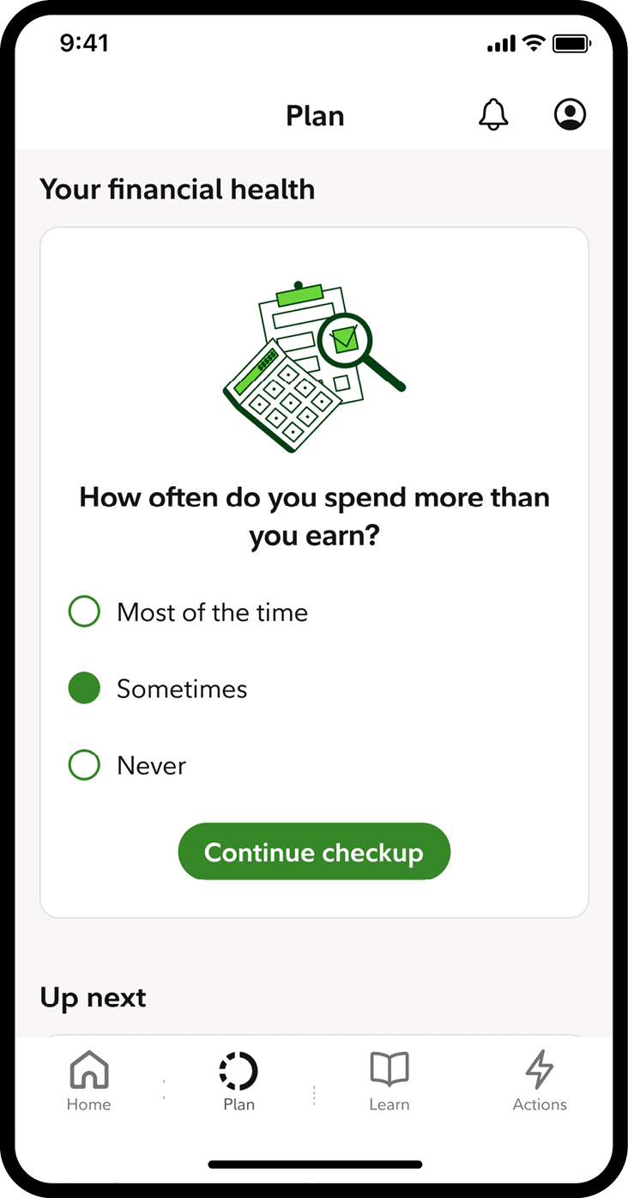
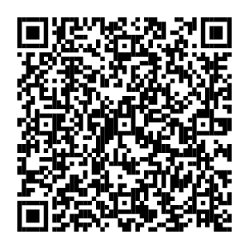
Take the Financial Wellness Checkup
In just a few minutes, you can explore ways to get more from your money, including the following:
Step-by-step help with making decisions
A tailored action plan
Support that fits your life and money goals
To take the checkup, scan the code or visit
NetBenefits.com/financialwellnesshelp.
Screenshot is for illustrative purposes only.
NetBenefits and the Fidelity Investments logo are registered service marks of FMR LLC. Fidelity Brokerage Services LLC, Member NYSE, SIPC, 900 Salem Street, Smithfield, RI 02917
© 2025 FMR LLC. All rights reserved.
1061555.2.1

